Slide 1
Introduction to Artificial Intelligence
CS 3793/5233 – AI
Summer 2020
-Kevin Desai

Slide 2

Introduce Yourself!
Share the following
Future career goals
Why this course?
What you expect to learn from this course?
Post a message on the Discord server in the 3793 channel
We will refer to the AI course as CS 3793, even though you may have registered for 5233 course, since both are cross-listed

Slide 3
Course Information
AI Impacts
Intro to Artificial Intelligence
History of AI

Slide 4
Course Information
AI Impacts
Intro to Artificial Intelligence
History of AI

Slide 5
Course Description
Discussion of theorem-proving by machine; includes computational linguistics, psychological modeling, and computer games.
Prerequisites: CS 3343 and CS 3423 and Python programming

Slide 6
What is this course?
Introduction to Artificial Intelligence, history and ethics
Building intelligent agents (searching, planning, games, logic, constraint satisfaction problems)
Machine Learning algorithms
Applications of AI (Natural Language Processing, Computer Vision, GameAI)
Benefits of AI; job displacement & future; impact on enterprises, society and daily life; security concerns

Slide 7
Course Objectives
At the end of the course you will be able to:
Define Artificial Intelligence and Outline the brief history of AI.
Make and Use intelligent agents for different types of problems (searching, planning, games, constraint satisfaction problems).
Analyze and Improve the data for better application of AI algorithms using Data Science techniques.
Classify the problem based on data provided and Choose different Machine Learning algorithms.
Develop deep learning models for real-world AI problems in Natural Language Processing & Computer Vision, using Python.

Slide 8
What this course is NOT?
Deep-dive into all AI subtopics
Machine Learning
Deep Learning
Computer Vision
Natural Language Processing
Robotics
. . .

Slide 9
Textbook
Artificial Intelligence: A Modern Approach (3rd Edition) by Stuart Russell and Peter Norvig

Slide 10
Course Website
The Learning Management System is Blackboard http://utsa.blackboard.com
All information, announcements, slides, assignments, quizzes and submissions will be through our Blackboard course.
Discord for discussion, Q/A, office hours, help.

Slide 11
Grading – CS 3793
Quizzes 20%
Programming Assignments 50%
Exams 30%

Slide 12
Grading – CS 5233
Research Presentation 10%
Quizzes 10%
Programming Assignments 50%
Exams 30%

Slide 13
Assignments
5 individual assignments
Programming assignments using Python on Google Colab
25% penalty for day-1, 50% penalty for day-2, not accepted after that
Last submission will be graded. Usually due Sunday @ 11:59 pm

Slide 14
Quizzes
Approx. 10 quizzes
Each consists of 5 to 20 questions – mostly T/F, multiple-choice and short answer questions.
Quizzes are timed and are administered on Blackboard and completed outside of class.
Quizzes are open-book and open-note. Cannot save and work on it later.
Only one submission allowed. No late submissions allowed. Due Sunday @ 11:59 pm

Slide 15
Exams
Exam-1
Due – June 28, 11:59 pm
Online on Blackboard
Exam-2
Due – Aug 6, 11:59 pm
Online on Blackboard

Slide 16
CS 5233 – Final Paper Presentation
Aug 7 – 10:30 am – 1:00 pm
Live on Blackboard Collaborate Ultra
One of the following:
Read 3+ papers and summarize them
Present current/future research work for any AI topic

Slide 17
Help?
You are not alone! If you need help, consult:
Your professor
Your TA
Your classmates
Discord, email
Don't be shy!

Slide 18

Communications
Post a message on the Discord channel
Short questions about the course topic
Email – CS 3793-(question) in the subject header
Personal questions/Grades that can’t be asked on Discord
Please wait 1-2 business days for a response
If no response, send a reminder
Don’t wait for the last minute
Use your UTSA email address (abc123@my.utsa.edu or firstname.lastname@utsa.edu)

Slide 19
Academic Expectations
All students are expected to do their own work on all assignments. Direct copying of code from other students or other resources is never allowed. In the event that you are allowed to use other resources, you will need to provide appropriate citations and attributions.
Assignments will be periodically processed through plagiarism detection software that is designed specifically for source code.

Slide 20
Tentative Schedule
Day | Type | Topics | Coursework Due
Week 0
May 27 | Lecture | Course Setup, Intro to AI, History, Impacts
Week 1
June 1 | Lecture | Google Colab, Python Review | Quiz-01
June 3 | Lecture | Intelligent Agents, PEAS, Searching
Week 2
June 8 | Lecture | Uninformed Search | Quiz-02
June 10 | Lecture | Informed Search
Week 3
June 15 | Lecture | Other Search | Quiz-03, Assignment-1
June 17 | Lecture | Adversarial Search
Week 4
June 22 | Lecture | Constraint Satisfaction | Quiz-04
June 24 | Lecture | Constraint Satisfaction (cont'd)
Week 5
June 29 | Lecture | Data Science | Quiz-05, Exam-1, Assignment-2
July 1 | Lecture | Machine Learning

Slide 21
Tentative Schedule
Day | Type | Topics | Coursework Due
Week 6
July 6 | Lecture | Supervised & Unsupervised Learning | Quiz-06
July 8 | Lecture | Neural Networks
Week 7
June 1 | Lecture | Deep Learning & TensorFlow | Quiz-07, Assignment-3
June 3 | Lecture | Deep Learning & TensorFlow Hands-on
Week 8
June 8 | Lecture | Computer Vision | Quiz-08
June 10 | Lecture | Computer Vision Hands-on
Week 9
June 15 | Lecture | Natural Language Processing | Quiz-09
June 17 | Lecture | Natural Language Processing Hands-on
Week 10
June 22 | Lecture | Reinforcement Learning | Quiz-10, Assignments-4,5
June 24 | Lecture | AI Ethics & Conclusion
Finals
June 29 | Exam | Final Exam Day – 5233 Paper Presentation | Exam-2

Slide 22
Questions

Slide 23
Course Information
AI Impacts
Intro to Artificial Intelligence
History of AI

Slide 24
AI Definitions
Artificial intelligence (AI) can be defined as the simulation of human intelligence processes by machines, especially computer systems. These processes include learning, remembering, reasoning, planning, communicating, and interacting with its environment.
AI can also be defined as a system’s ability to correctly interpret external data, to learn from such data, and to use those learnings to achieve specific goals and tasks through flexible adaptation.

Slide 25
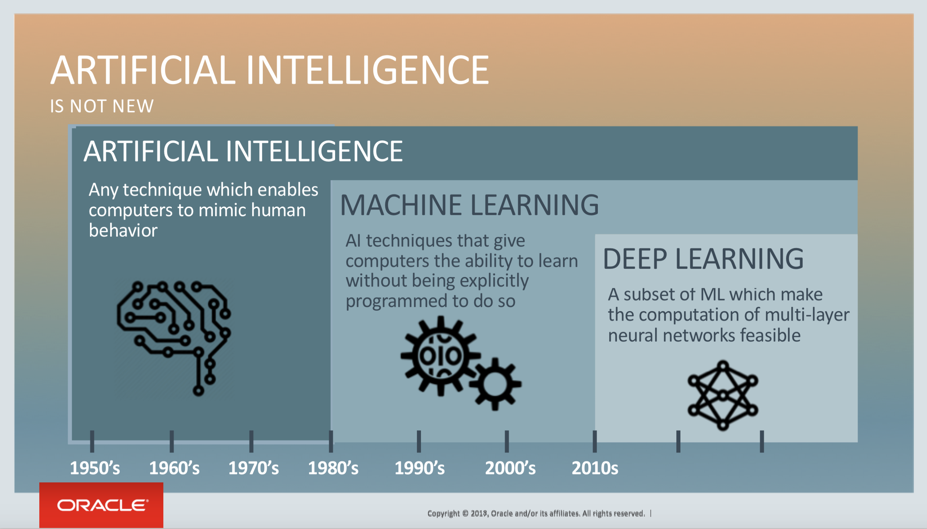
AI Definitions
https://blogs.oracle.com/bigdata/difference-ai-machine-learning-deep-learning

Slide 26

AI Definitions
Artificial Intelligence – Human Intelligence Exhibited by Machines
Machine Learning — An Approach to Achieve Artificial Intelligence
Deep Learning — A Technique for Implementing Machine Learning
https://blogs.nvidia.com/blog/2016/07/29/whats-difference-artificial-intelligence-machine-learning-deep-learning-ai/

Slide 27
AI Definitions
 | Humanly | Rationally
Thinking | “The exciting new effort to make computers think . . . machines with minds, in the full and literal sense.” (Haugeland, 1985) “[The automation of] activities that we associate with human thinking, activities such as decision-making, problem solving, learning . . .” (Bellman, 1978) | “The study of mental faculties through the use of computational models.” (Charniak and McDermott, 1985) “The study of the computations that make it possible to perceive, reason, and act.” (Winston, 1992)
Acting | “The art of creating machines that perform functions that require intelligence when performed by people.” (Kurzweil, 1990) “The study of how to make computers do things at which, at the moment, people are better.” (Rich and Knight, 1991) | “Computational Intelligence is the study of the design of intelligent agents.” (Poole et al., 1998) “AI . . . is concerned with intelligent behavior in artifacts.” (Nilsson, 1998)

Slide 28
AI Definitions
 | Humanly | Rationally
Thinking | Cognitive Modeling Systems should solve the same way humans do | Laws of Thought Systems must somehow model uncertainty and deal with complexity
Acting | The Turing Test | Rational agents Maximize the expected outcome of their performance

Slide 29
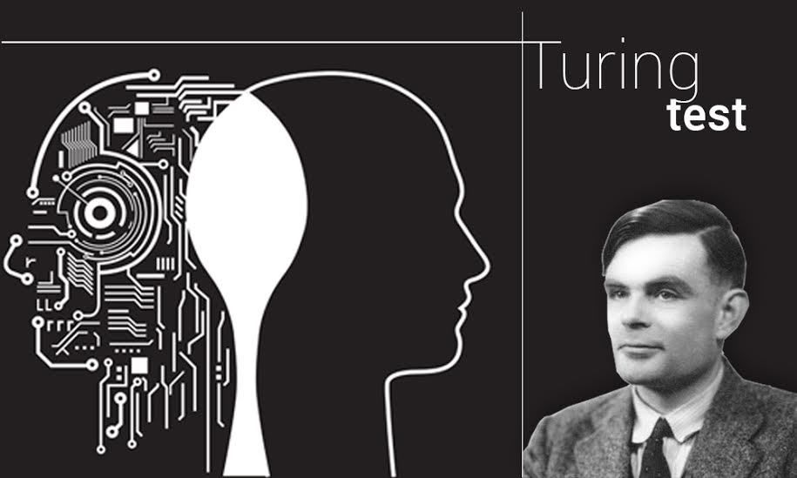
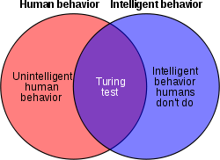
The Turing Test
Source: Wikipedia
Developed by Alan Turing in 1950
A test of a machine’s ability to exhibit intelligent behavior, equivalent to or indistinguishable from a human.
https://www.analyticsindiamag.com/turing-test-key-contribution-field-artificial-intelligence/

Slide 30
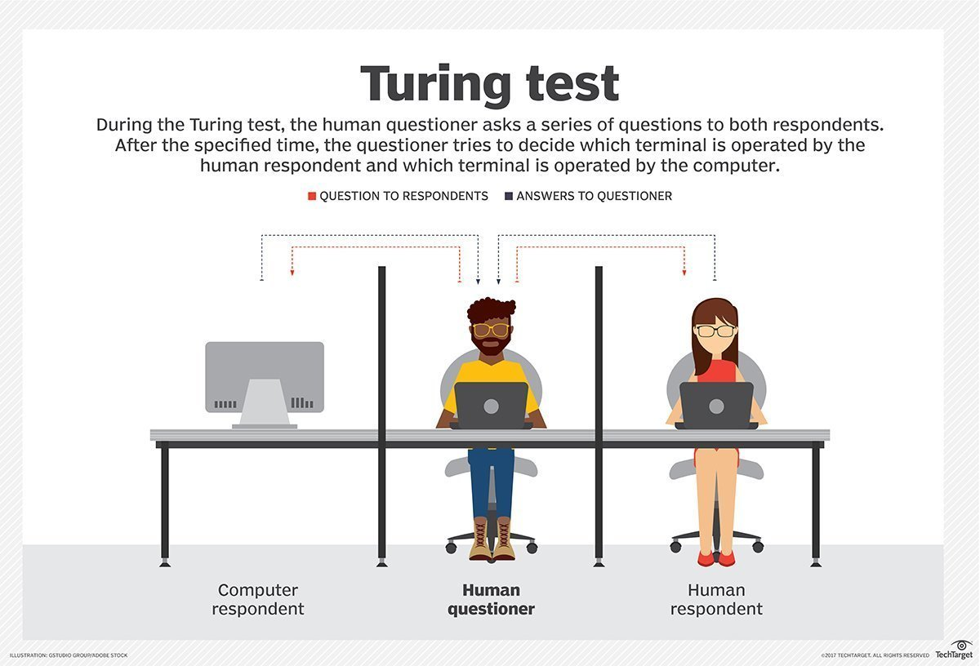
The Turing Test
natural language processing to enable it to communicate successfully in English
knowledge representation to store what it knows or hears
automated reasoning to use the stored information to answer questions and to draw new conclusions
machine learning to adapt to new circumstances and to detect and extrapolate patterns

Slide 31
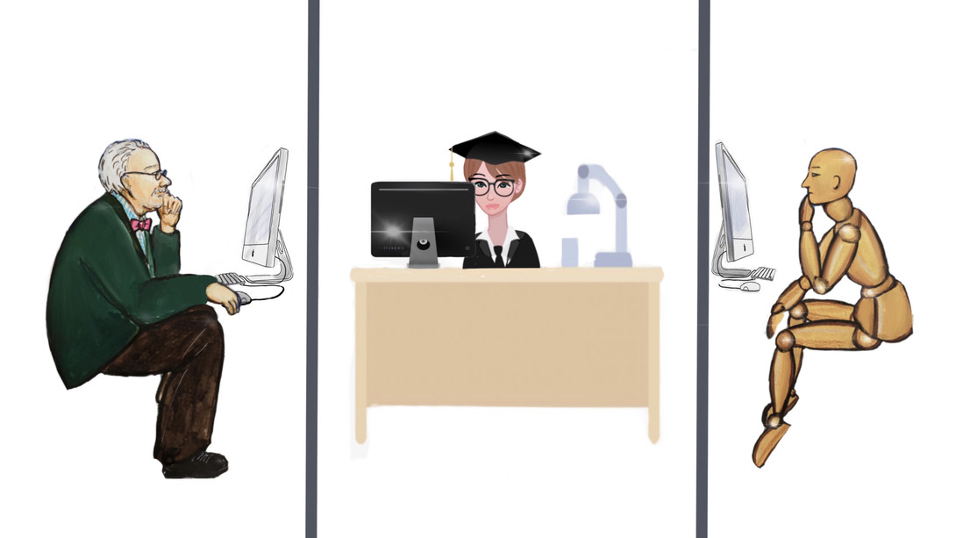
The ‘Total’ Turing Test
computer vision to perceive objects
robotics to manipulate objects and move about
https://wsimag.com/science-and-technology/36961-no-turing-test-for-consciousness

Slide 32
Cognitive Modeling
Program that ‘thinks like human’
Determine how humans think through
Introspection – trying to catch our own thoughts as they go by
Psychological experiments – observing a person in action
Brain imaging – observing the brain in action
The interdisciplinary field of cognitive science brings together computer models from AI and experimental techniques from psychology to construct precise and testable theories of the human mind.

Slide 33
Laws of Thought
Program that ‘thinks rationally’
“Socrates is a man; all men are mortal; therefore, Socrates is mortal.”
By 1965, programs existed that could, in principle, solve any solvable problem described in ‘logical’ notation.
Main obstacles to this approach -
It is not easy to take informal knowledge and state it in the formal terms required by logical notation, particularly when the knowledge is less than 100% certain.
There is a big difference between solving a problem “in principle” and solving it in practice (in terms of computer resources).

Slide 34
Rational Agents
Program that ‘acts rationally’
A rational agent is one that acts so as to achieve the best outcome or, when there is uncertainty, the best expected outcome.
More general approach than the “laws of thought” approach because correct inference is just one of several possible mechanisms for achieving rationality.
The standard of rationality is mathematically well defined and completely general, and can be ‘unpacked’ to generate agent designs that provably achieve it.
Human behavior, on the other hand, is well adapted for one specific environment and is defined by, well, the sum total of all the things that humans do.

Slide 35
Course Information
AI Impacts
Intro to Artificial Intelligence
History of AI

Slide 36
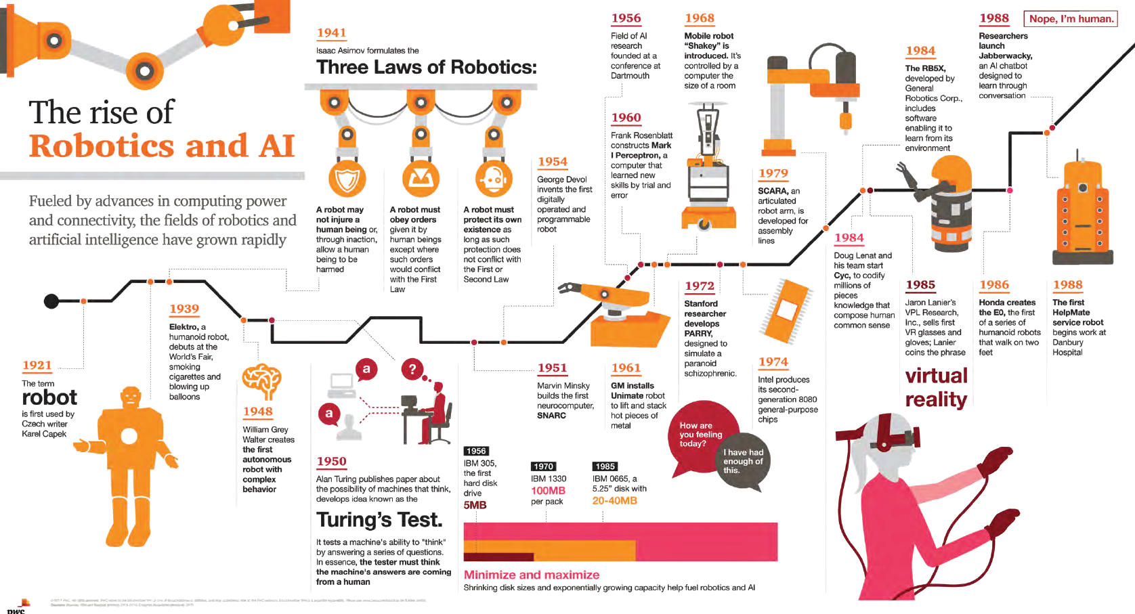
History of AI
http://usblogs.pwc.com/emerging-technology/rise-robotics-ai-infographic/

Slide 37
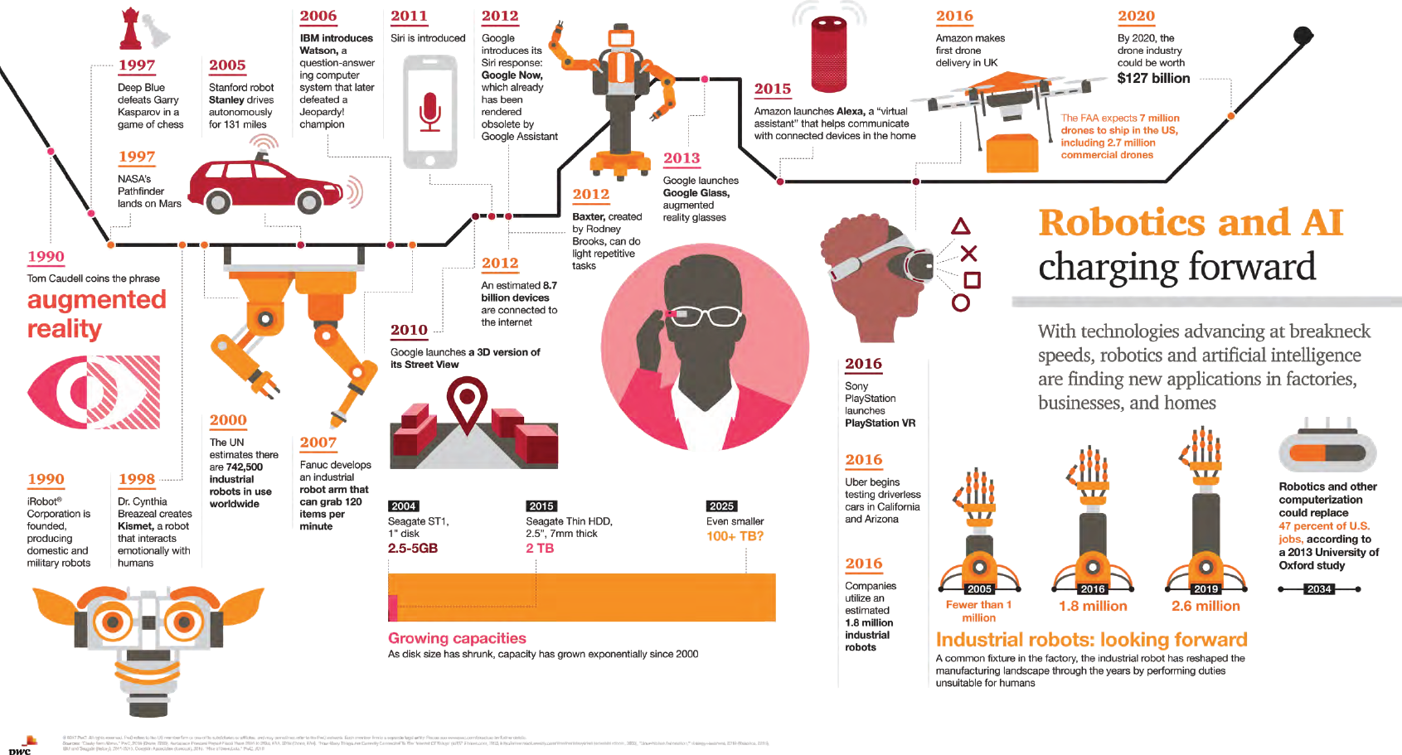
History of AI
http://usblogs.pwc.com/emerging-technology/rise-robotics-ai-infographic/

Slide 38
Course Information
AI Impacts
Intro to Artificial Intelligence
History of AI

Slide 39
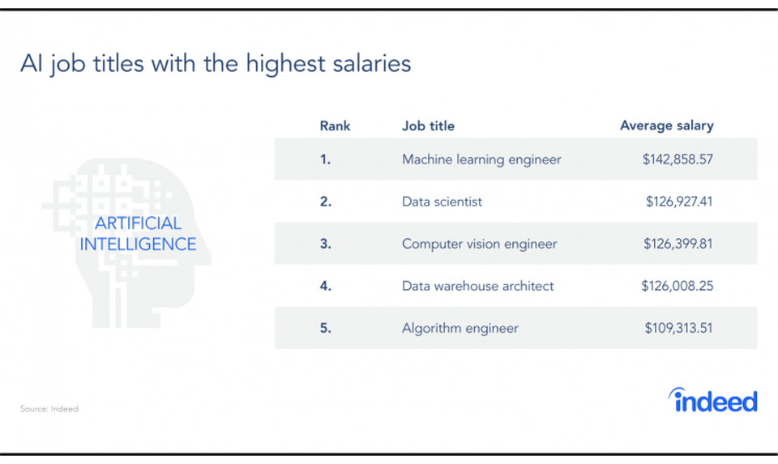
https://www.forbes.com/sites/louiscolumbus/2019/06/30/indeeds-10-most-popular-ai-machine-learning-jobs-this-year/#73de2281547d

Slide 40
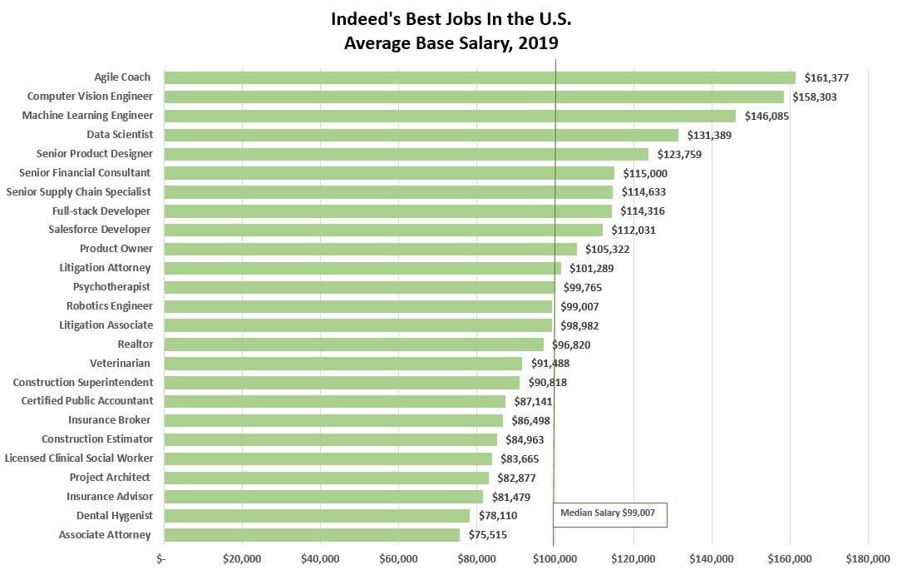
https://www.forbes.com/sites/louiscolumbus/2019/03/17/machine-learning-engineer-is-the-best-job-in-the-u-s-according-to-indeed/#137aef0f7bb0

Slide 41
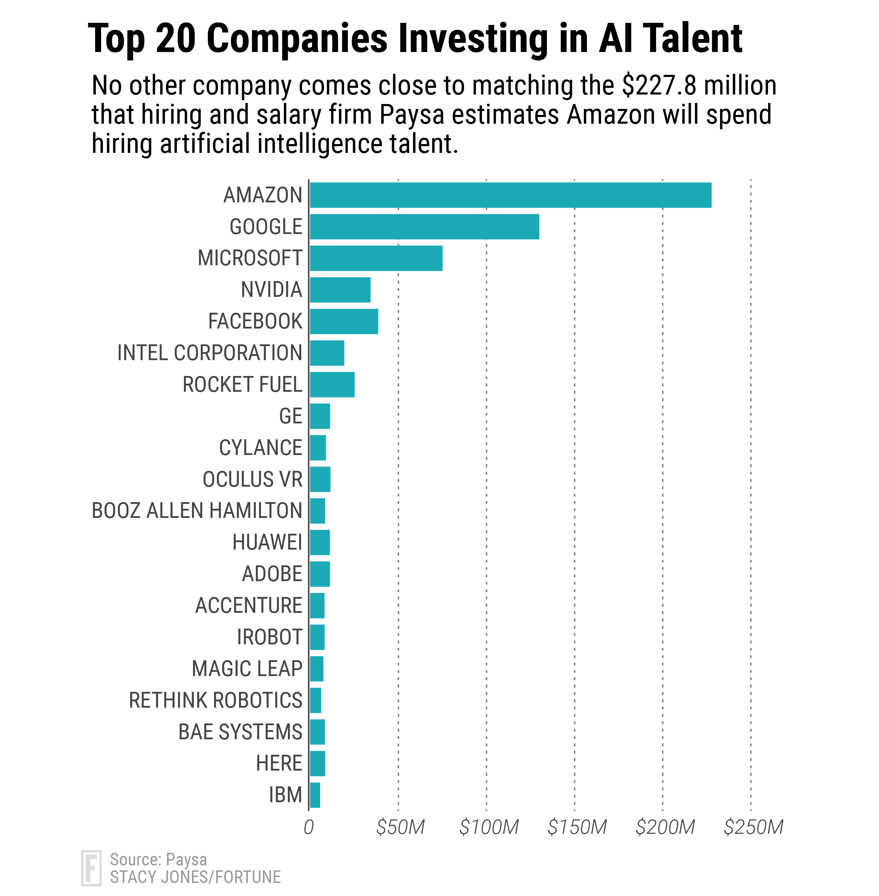
https://fortune.com/2017/05/01/automation-jobs-will-put-10000-humans-to-work-study-says/

Slide 42
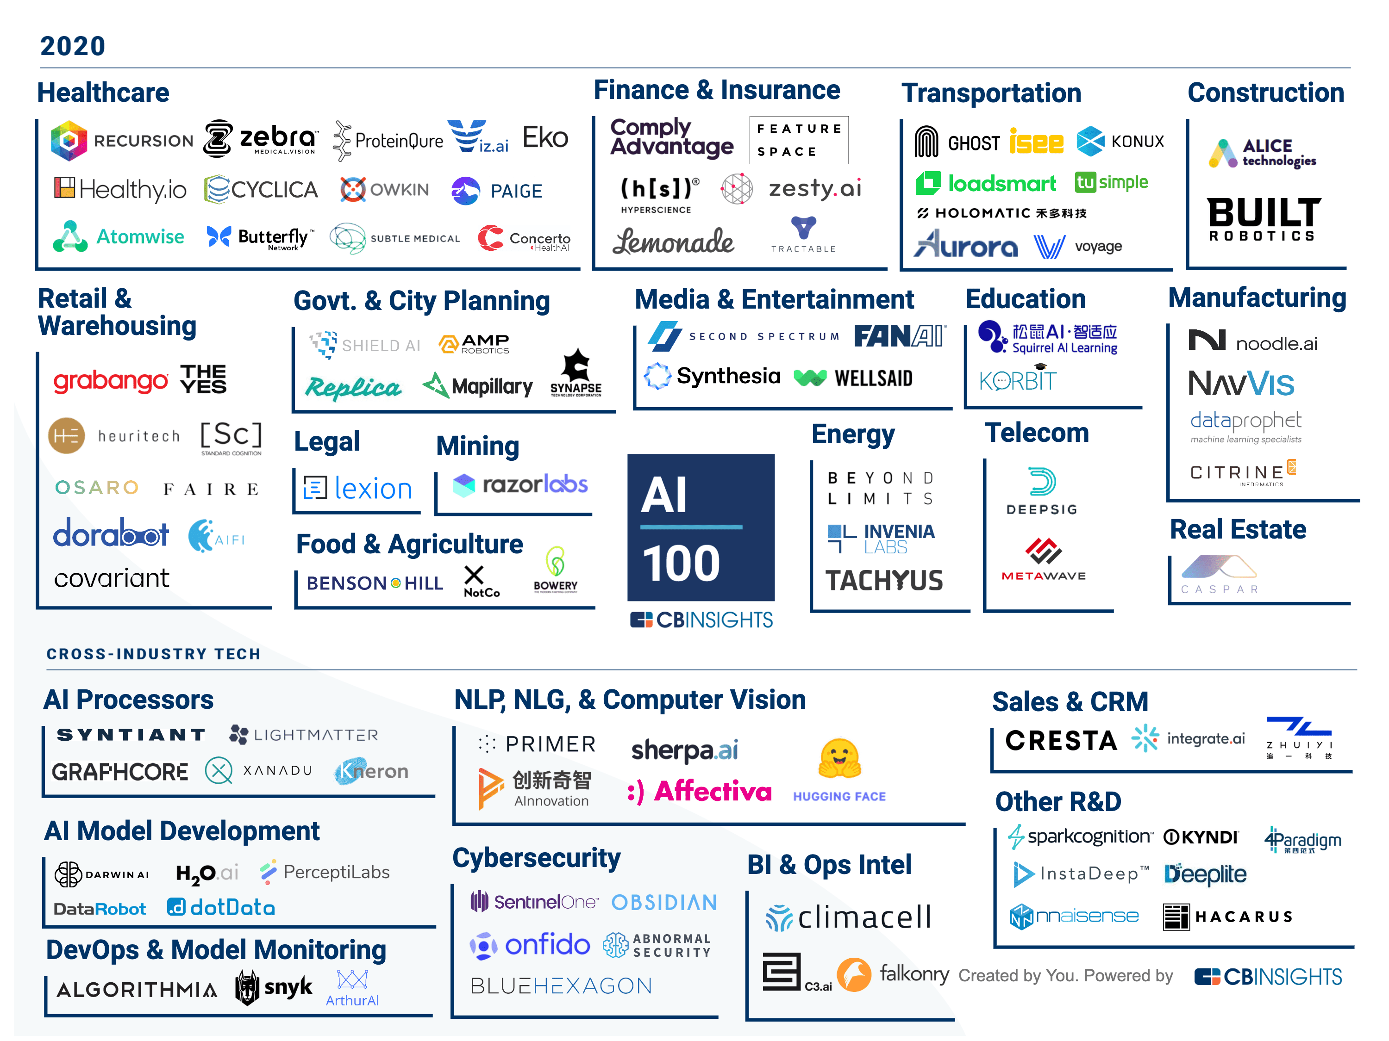
https://www.cbinsights.com/research/artificial-intelligence-top-startups/

Slide 43
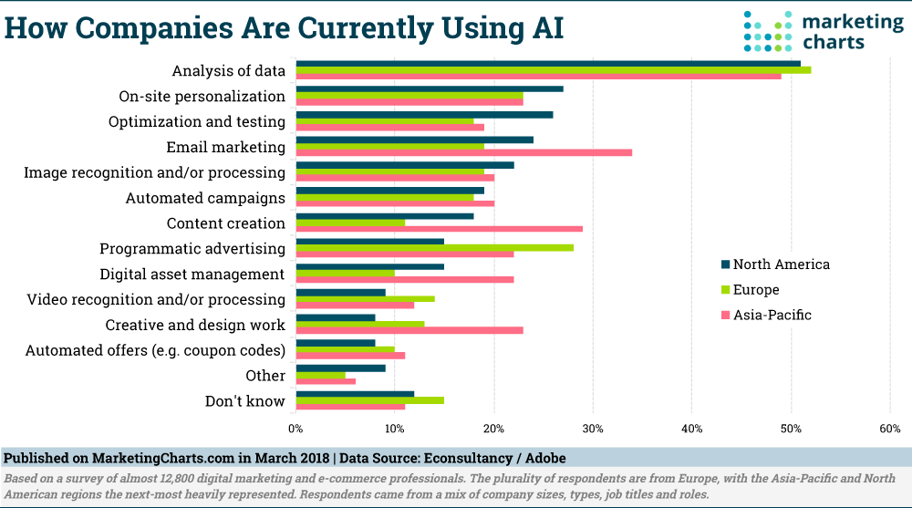
https://www.marketingcharts.com/customer-centric/analytics-automated-and-martech-82540/attachment/econsultancyadobe-how-companies-are-using-ai-mar2018

Slide 44
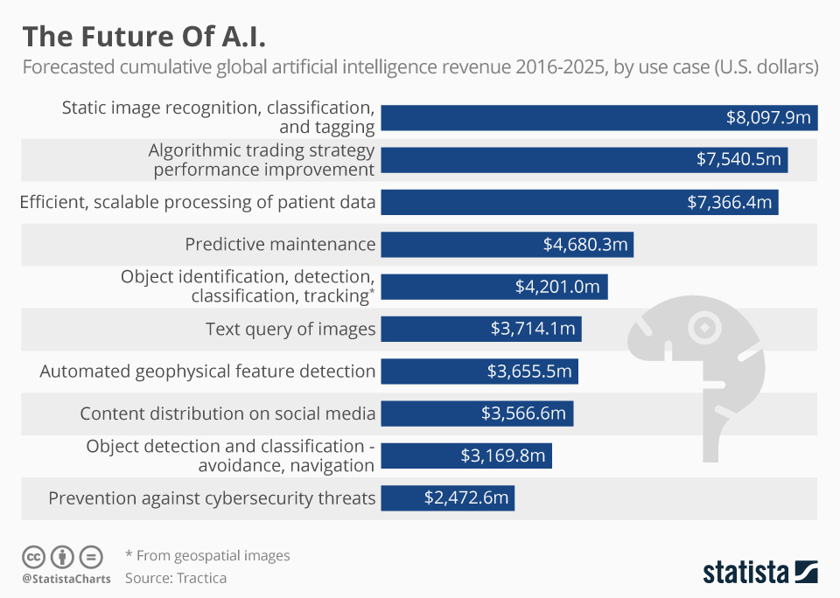
https://www.statista.com/chart/6810/the-future-of-ai/

Slide 45
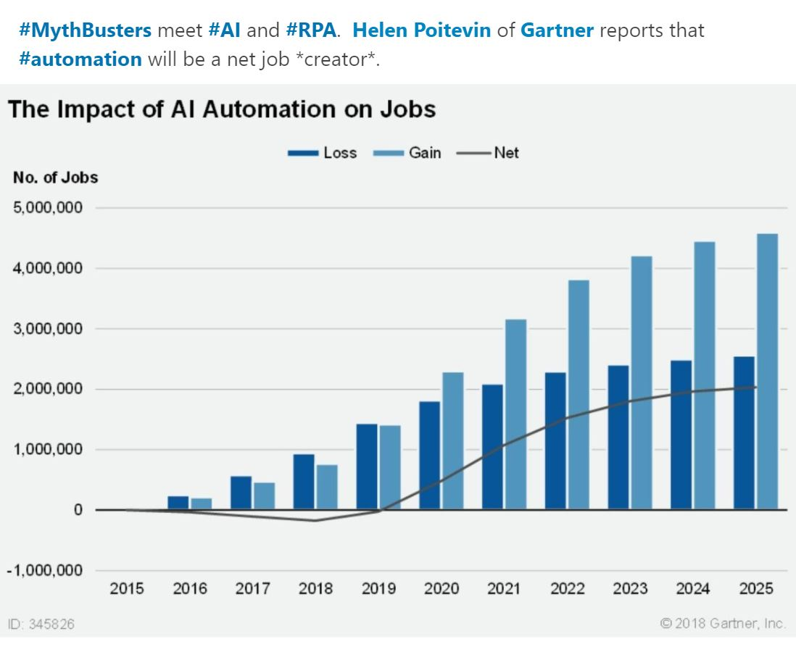
https://www.horsesforsources.com/gartner_fail_automation-AI_080418

